Slide 1
3. Time-frequency representations: filter banks and transforms
Xavier Serra

Slide 2
Index
Digital filters: FIR, IIR
Resampling of signals
Filter banks
Quadrature mirror filters
Fourier analysis
Discrete Fourier Transform (DFT)
Discrete Cosine Transform (DCT)
Short Time Fourier Transform (STFT)
Modified Discrete Cosine Transform (MDCT)

Slide 3
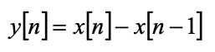
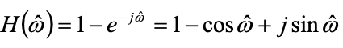
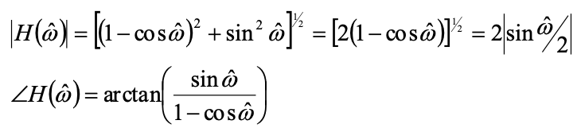
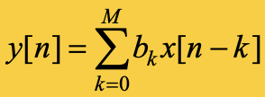
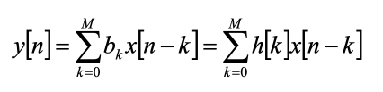
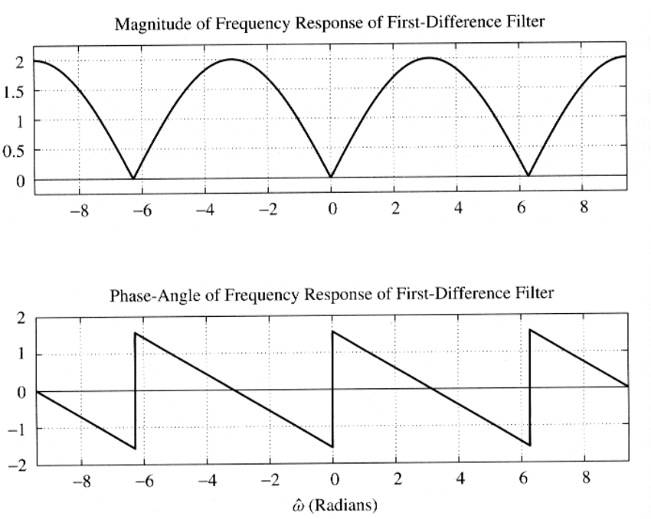
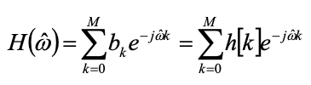
Finite Impulse Response
filters

Slide 4
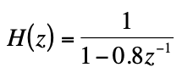
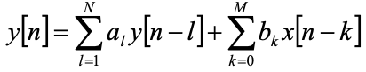
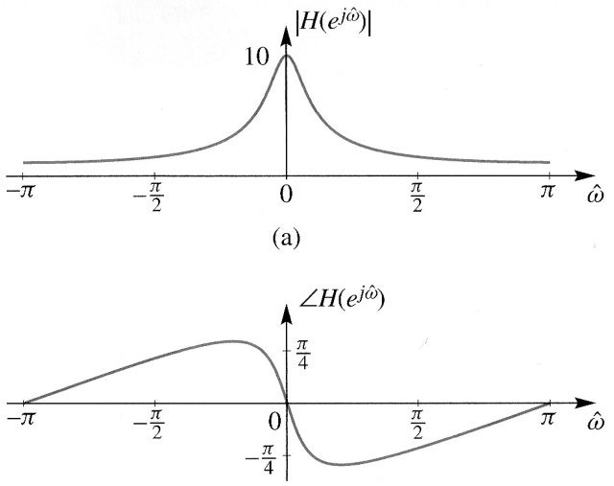
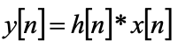
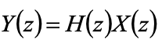
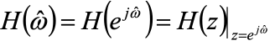
Infinite Impulse Response filters

Slide 5
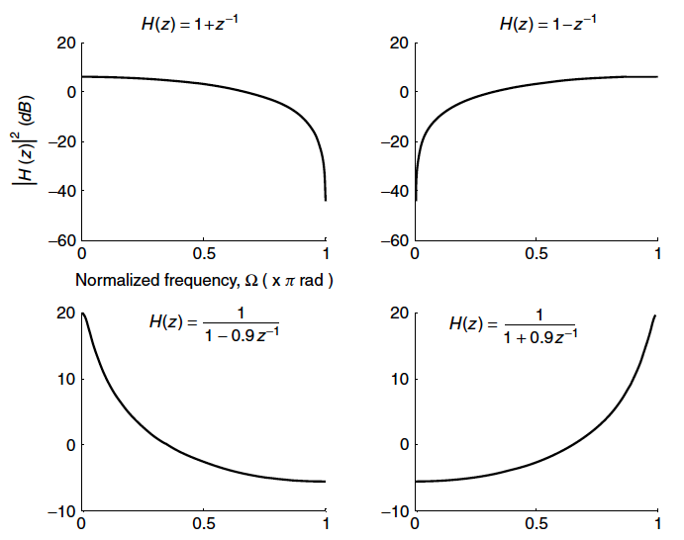
FIR and IIR example

Slide 6
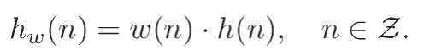
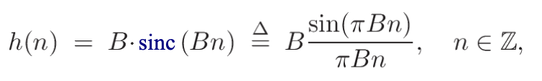
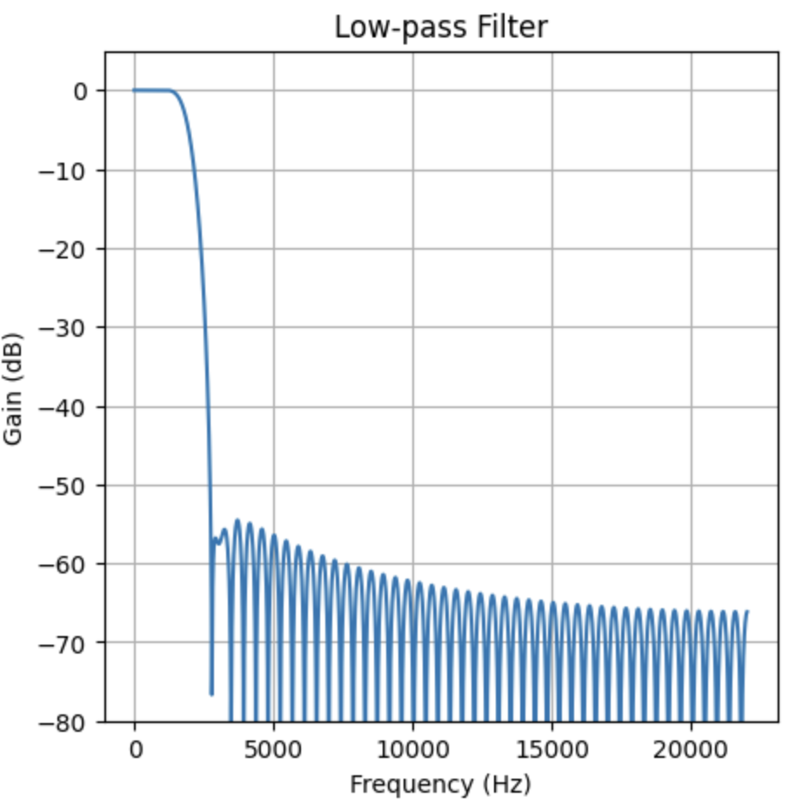
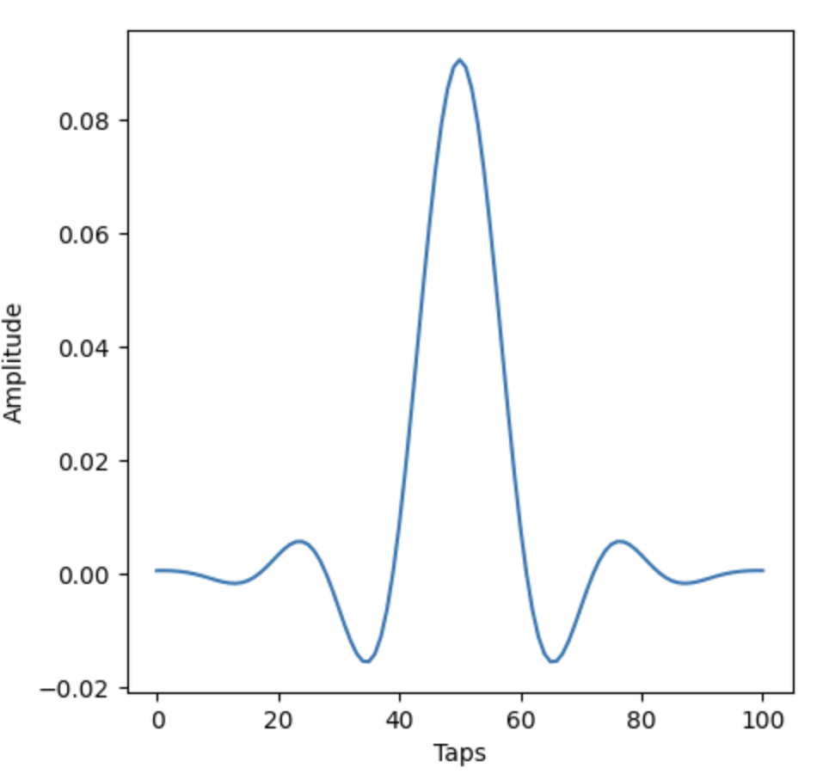
Filter design: window method (firwin)
Windowing a theoretically ideal impulse response h(n) by some suitable chosen window function w(n), yielding
Ex: the ideal impulse response of a lowpass filter in the sinc function
where B = 2f_c is the normalized bandwidth in Hz and f_c is the cutoff frequency in Hz.
filter length = 101
f_c = 2000 Hz

Slide 7
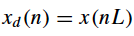
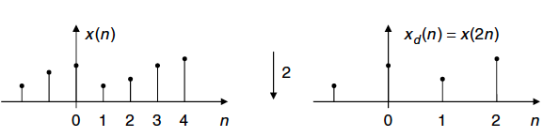
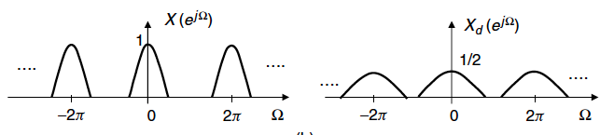
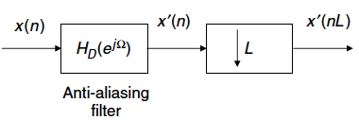
Downsampling

Slide 8
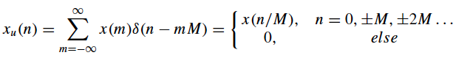
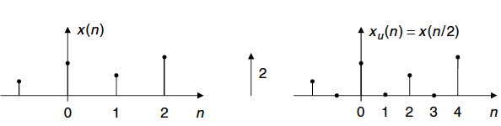
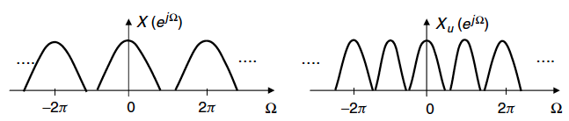
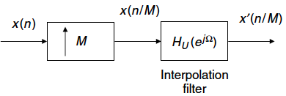
Upsampling

Slide 9
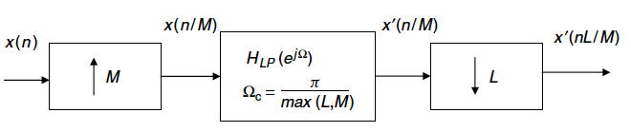
Sampling rate changes by non-integer factor

Slide 10
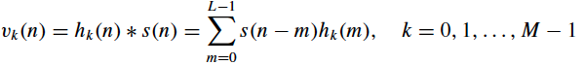
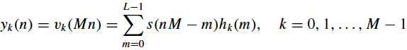
Filter banks
An input signal s(n) is processed at the encoder by a parallel bank of (L - 1)-th order FIR bandpass filters, H_k(z). The bandpass analysis outputs,
are decimated by a factor of M, yielding the subband sequences
which comprise a critically sampled or maximally decimated signal representation, i.e., the number of subband samples is equal to the number of input samples.

Slide 11
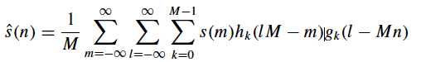
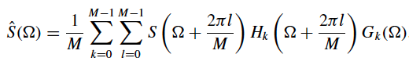
Because it is impossible to achieve perfect “brickwall” magnitude responses with finite-order bandpass filters, there is unavoidable aliasing between the decimated subband sequences.
Quantization and coding are performed on the subband sequences y_k(n).
The quantized subband samples are eventually received by the decoder, where they are upsampled by M.
To eliminate the imaging distortions introduced by the upsampling the samples are processed by a parallel bank of synthesis filters, G_k(z), and the filter outputs are combined to form the overall output.

Slide 12
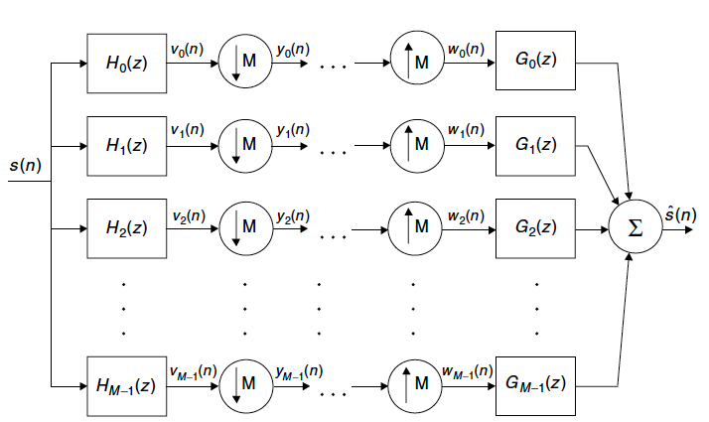

Slide 13
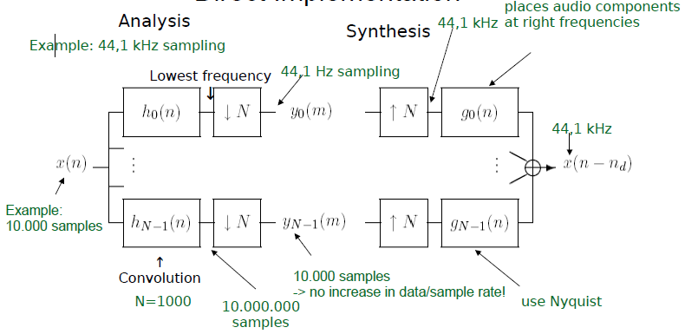

Slide 14
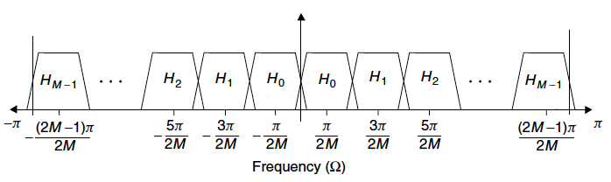
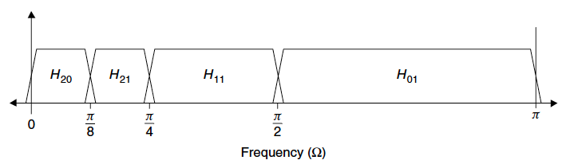
uniform M-band filter bank
octave-band filter bank

Slide 15
Ideal filters
Ideal filters are not realizable.
In the time domain they would mean a convolution of our signal with a Sinc function.
Sinc function is infinitely long and not causal, meaning it causes infinite delay.
We can not simply use a DFT or FFT to obtain an ideal filter in the frequency domain either.
Because the DFT also represents a filter bank, but a special type.
Its equivalent filters are far from perfect filters (hence we cannot make ideal filters with it), not good enough for our purposes (audio coding and the ear), as we will see.

Slide 16
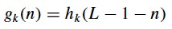
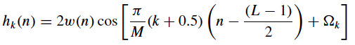
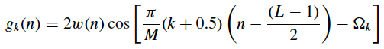
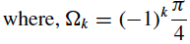
Cosine modulated filter banks
Cosine modulation of a lowpass prototype filter can realize parallel M-channel filter banks with nearly perfect reconstruction (called “Pseudo QMF”).
Analysis and synthesis filters satisfy the mirror image condition
and the sequence w(n) corresponds to the L-sample “window”, a real-coefficient linear phase FIR prototype lowpass filter, with normalized cutoff frequency pi/2M.

Slide 17
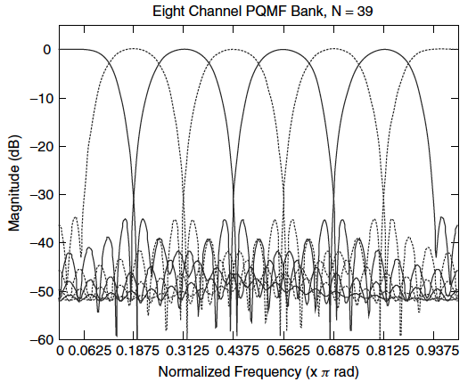
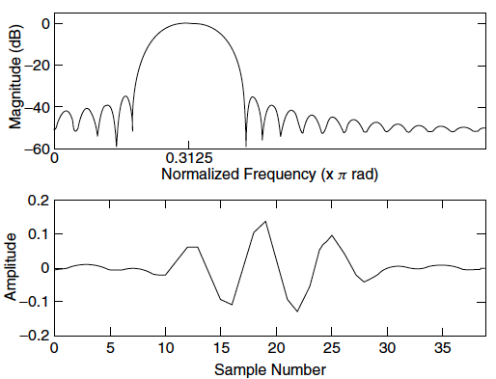
Pseudo Quadrature Mirror Filters (PQMF)
Magnitude frequency response and impulse response for channel 3.

Slide 18
Implementation
Analysis Filter Bank: The input audio signal is passed through a bank of analysis filters, which splits the signal into multiple subbands.
Downsampling: Each subband is then downsampled to reduce the data rate.
Encoding/Decoding (Optional): Quantization or other encoding techniques can be applied to each subband for compression.
Upsampling: The downsampled subbands are upsampled back to their original rate.
Synthesis Filter Bank: The upsampled subbands are passed through a synthesis filter bank to reconstruct the audio signal.

Slide 19
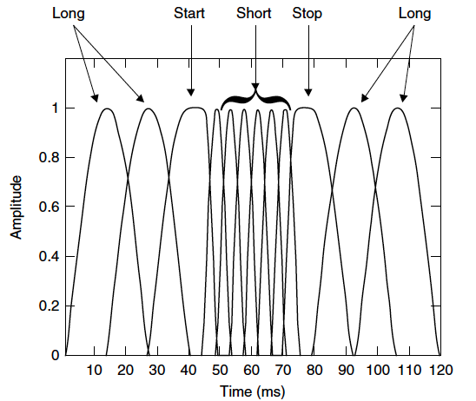
Hybrid, switched filter banks

Slide 20
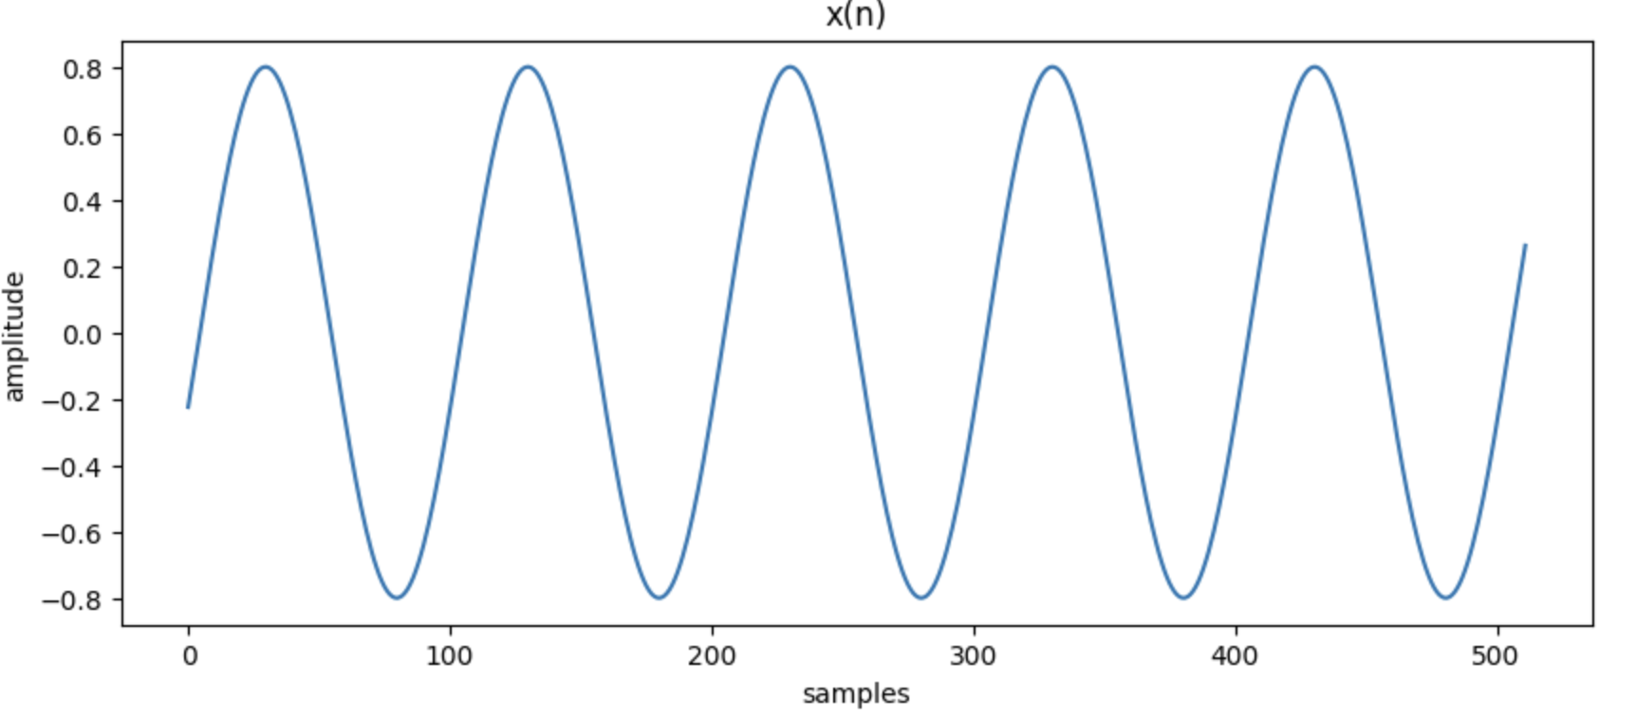
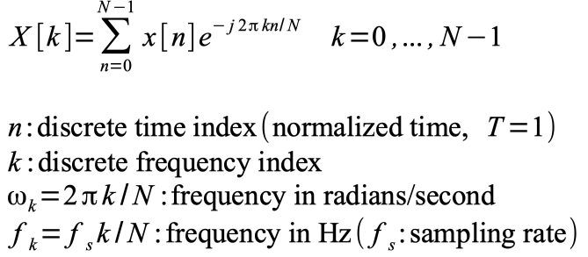
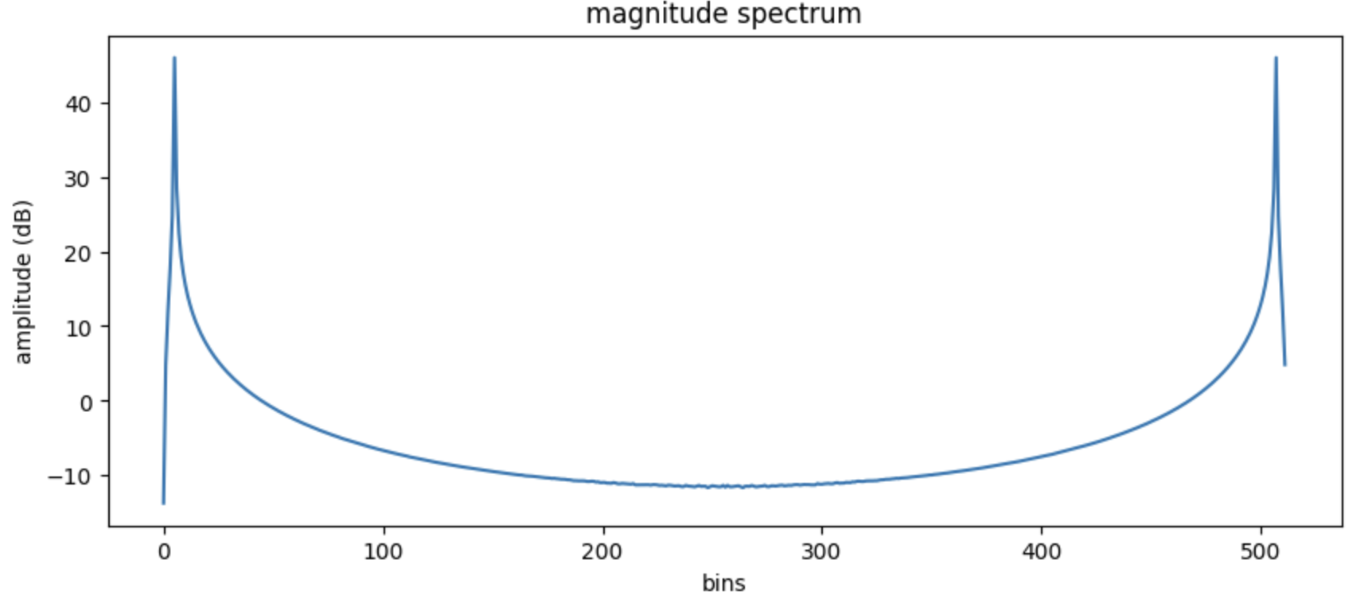
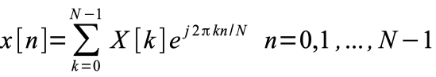
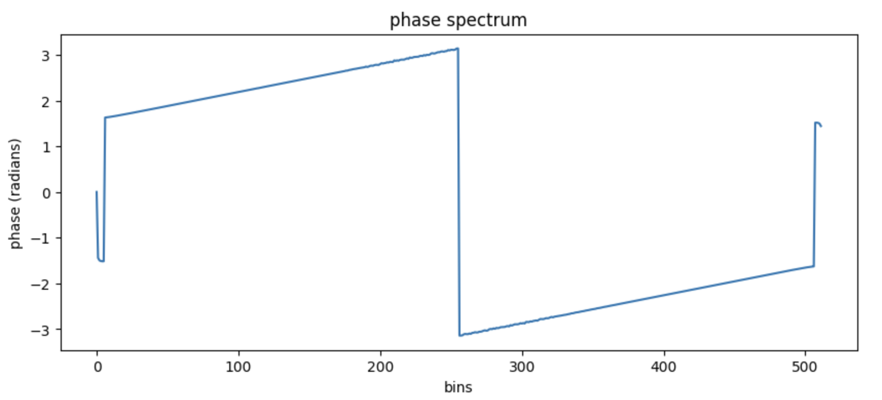
Discrete Fourier Transform (DFT)

Slide 21
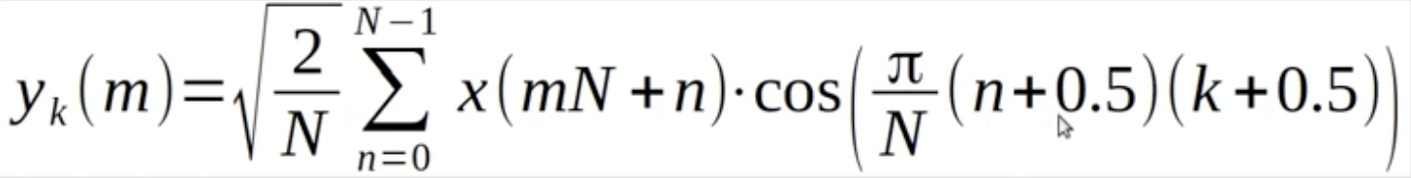
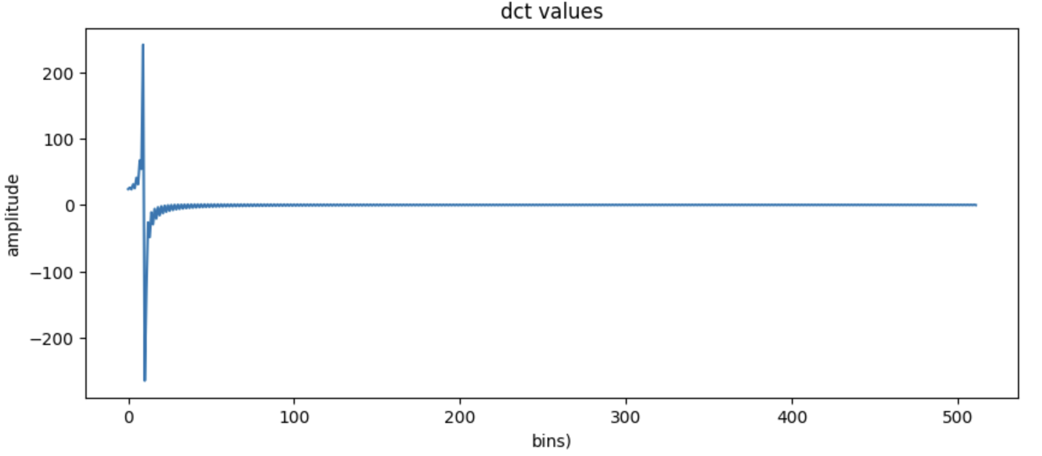
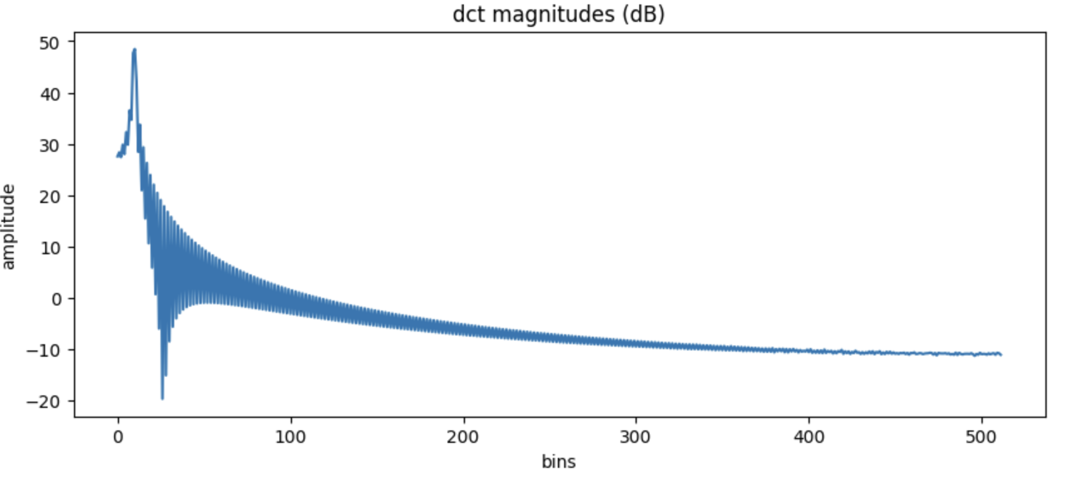
Discrete Cosine Transform (DCT)
DCT Type 4

Slide 22
DFT vs DCT
The DFT is the basic frequency-domain transformation, conceptually easy to understand, and suitable for most kind of spectral analysis and spectral transformations. However, DFT requires overlapping between windows, but it doubles the information that need to be stored: not very good for compression.
DCT returns a real-valued spectrum (only the positive frequencies). It has twice as many frequency values for the same number of time-domain samples.

Slide 23



Short-time Fourier Transform (STFT)

Slide 24









Windows
Rectangular window:
Sine window:
Hanning window:

Slide 25

Modified Discrete Cosine Transform (MDCT)
Solves the data rate problem inherent in DFT coders. No window overlap.
It is a class of Time Domain Alias Cancelation (TDAC) transforms.
It does not invert like the DFT to recover the input signal. It includes time-domain aliasing which is cancelled in the time domain. Thus it allows for perfect reconstruction.
It can be implemented with the FFT.

Slide 26


Magnitude frequency response and impulse response for channel 3.

Slide 27


Time-frequency resolution issues
Difficulty of selection a single filter bank to satisfy the diverse time and frequency resolutions requirements associated with different classes of audio.
castanets
piccolo

Slide 28


STFT vs MCDT
STFT built on top of DFT and MCDT built on top of DCT Type 4
MCDT has not window overlap, it is critically sampled
STFT, no window overlap
MCDT

